Slide 1
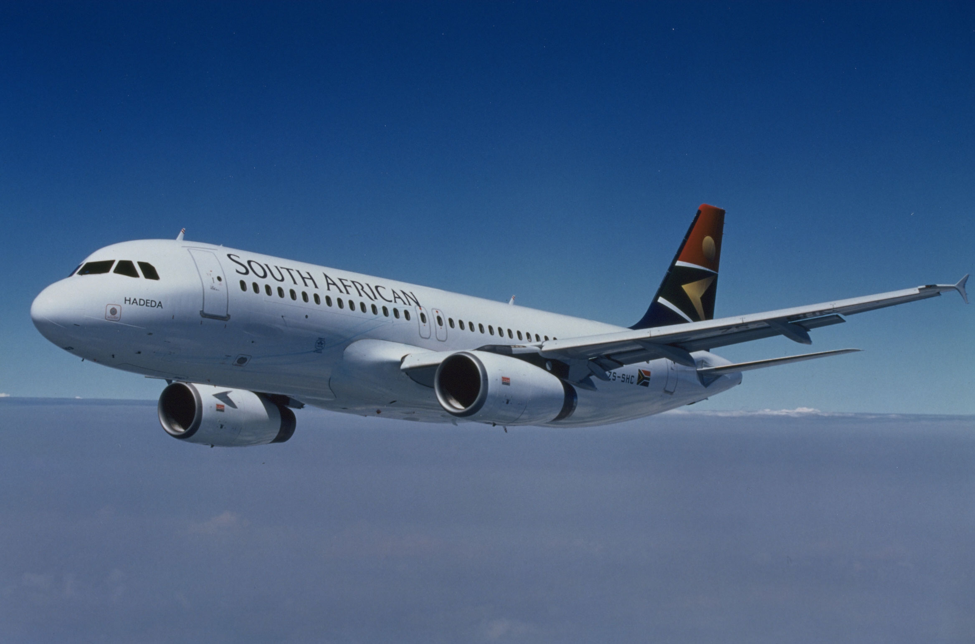
I – Principles of straight and steady level flight
Notes:
The goal of this first part of the course is to presents the principle of straight and steady level flight.
In this first part we will address only jet airplanes (powered by turbojets or turbofans) and we will assume that compressibility effects are negligible.
An other part of the course is dedicated to transonic and supersonic performance, when compressibility effects are significant.
Specifics of propeller driven airplanes are presented in a separate section.

Slide 2
1. Straight and steady level flight
Lift balances weight
Z
Lift
F
Thrust
X
Drag
V
Velocity vector
mg
Weight
An airplane has :
  wings to generate lift,
  engines to balance drag.
Thrust balances drag
Notes:
This figure presents the forces acting on an airplane in horizontal flight and the principles for equilibrium in stabilized flight (constant speed and altitude).
Note : We assume here that thrust is parallel to the velocity vector. This assumption is generally valid for conventional airplanes, but is not valid in the case of airplanes with vectored thrust (VTOL : Vertical Take-Off and Landing or STOVL : Short Take-off Vertical Landing). For those airplanes, the normal thrust component may balance a large part of the weight (in vertical flight, it balances the totality of the weight, its contribution decreasing during the transition to vertical flight).

Slide 3
1. Straight and steady level flight
Expressions for lift and drag :
  Lift : ½ρV² S Cz Drag : ½ρV² S Cx
    ½ρV² is the kinetic pressure, also noted q
    ρ is the air density (in kg/m³)
    V is the air velocity (in m/s)
    S is the wing reference surface (in m²)
    Cz and Cx are lift and drag coefficients
  Drag is parallel to the velocity vector and opposed to velocity (Cx is always positive)
  Lift is normal to the velocity vector (upwards when Cz is positive)
Notes:
This figure presents the forces acting on an airplane in horizontal flight and the principles for equilibrium in stabilized flight (constant speed and altitude).
The equations for horizontal flight are developed later (in chapter dedicated to straight and level flight).
The expression for lift is : ½ ρV² S Cz
is the air density S is the wing reference area
Cz is a non dimensional aerodynamic coefficient (lift coefficient)
Lift must balance weight, since there is a maximum value for the lift coefficient Cz is limited, there is a minimum airspeed value for the lift to balance drag.
The expression for drag is similar, lift coefficient Cz being replaced by drag coefficient Cx (lift and drag coefficients are sometimes noted C_{L} and C_{D} instead of Cz and Cx).
Note : We assume here that thrust is parallel to the velocity vector. This assumption is generally valid for conventional airplanes, but is not valid in the case of airplanes with vectored thrust (VTOL : Vertical Take-Off and Landing or STOVL : Short Take-off Vertical Landing). For those airplanes, the normal thrust component may balance a large part of the weight (in vertical flight, it balances the totality of the weight, its contribution decreasing during the transition to vertical flight).

Slide 4
1. Straight and steady level flight
Symmetrical flight
  Wings leveled (zero bank angle)
  Zero lateral force (zero sideslip angle)
Straight and level flight :
  velocity vector is horizontal
  Lift balances weight
Steady flight :
  Constant speed : thrust balances drag
Moment equilibrium is achieved by flight controls deflections
Notes:
This slide presents the principles of straight and steady level flight and some basic assumptions.
Symmetrical flight is assumed. At zero sideslip angle (velocity vector is in the aircraft plane of symmetry), if there is no asymmetry (from geometry, loading and propulsion), straight flight is achieved with wings leveled (zero bank angle).
To maintain straight and level flight, velocity vector must remain in horizontal plane. As a consequence, lift must balance weight : if lift exceeds weight, a normal acceleration develops, curving the trajectory upwards (downwards if lift is lower than weight).
To maintain steady flight at constant speed, lift must balance drag.
In this part, dealing with performance, we assume that moment equilibrium is achieved by proper flight controls deflections.

Slide 5
1. Straight and steady level flight
Angle of attack and pitch attitude
α
θ
Horizontal plane
V
Velocity vector
Angle of attack, α, is the angle between the velocity vector and the airplane longitudinal reference.
Lift and drag coefficients are functions of angle of attack.
Pitch attitude, θ, is the angle between the airplane longitudinal reference and the horizontal plane.
In straight and level flight, the velocity vector is horizontal : angle of attack equals pitch attitude : α = θ
Notes:
This slide presents the definitions for angle of attack and pitch attitude.
The above definition for angle of attack applies only to symmetrical flight (zero sideslip angle), a more general definition will be presented later.

Slide 6
1. Straight and steady level flight
Flight mechanics equations
→
→
→
d
→
Forces
Ra
+
F
+
m
g
=
(mVk)
dt
Thrust levers
Aerodynamics
Propulsion
Weight
Inertia
→
→
→
→
Ma_{/G}
+
MF_{/G}
d
→
Moments
=
dt
( I . Ω_{k})
Flight controls
Notes:
The forces and moment equations are used to predict airplane trajectory and attitude :
The time derivative of momentum is equal to the sum of external forces acting on the airplane.
The time derivative of angular momentum is equal to the sum of external moments acting on the airplane.
In the above formulation we consider the airplane in the air : on ground, for take-off and landing, ground reactions must be taken into account.
When flying an airplane, the pilot controls aerodynamic moments through flight controls and thrust through thrust levers (or power levers).
Note : In the above formulation, the airplane is considered as a solid. This is an approximation since :
Airplane structure are flexible.
The center of gravity location relative to the airplane may change along the flight, the main reason being fuel consumption and transfer. In addition to slow CG variations, with negligible impact on airplane motion, some effects such as fuel slosh (fuel displacement inside partially filled tanks) may have an impact short term motion (airplane natural modes).
In most cases, the above mentioned effects are neglected. However, flexibility effects must be taken into account for aerodynamic coefficients prediction.

Slide 7
1. Straight and steady level flight
Left/right Stick (or control wheel) controls rolling moment through ailerons (and spoilers)
Forward/aft stick (or control wheel) controls pitching moment through elevator
Rudder pedals control yawing moment through rudder
Flight controls are used to
control attitude
Notes:
This figure shows how flight controls are used to control airplane attitude.
The purpose of primary flight controls is to alter the aerodynamic moment around a given axis, but deflections have secondary effects on the aerodynamic forces and on other components of the aerodynamic moment. As an example, a rudder deflection induces a secondary rolling moment and a side force, in addition to yawing moment, and increases drag.
The configuration shown above is a typical commercial jet configuration, but there are other configurations such as :
delta airplanes (no horizontal tail),
twin vertical tails,
V tails,
flying wings,
Most propeller airplanes do not have spoilers nor speedbrakes.
Note : With the flight mechanics conventions for signs, as shown on the above figure, all flight control efficiencies are negative : the consequence of a positive deflection is a negative moment.

Slide 8
1. Straight and steady level flight
Equations for straight and steady level flight
Lift equation
mg = ½ρV² S Cz lift balances weight
Propulsion equation
F = ½ρV² S Cx thrust balances drag
To maintain straight and steady level flight :
  Angle of attack is controlled by elevator deflection in order to maintain lift equilibrium (lift = weight)
  Thrust is controlled by thrust levers in order to maintain thrust equilibrium
Notes:
This slide presents the simpler form for lift equation and propulsion equation.
In straight and steady level flight, lift equation represents the equilibrium between lift and weight.
To achieve this equilibrium, the pilot (human pilot or automatic pilot) controls the lift through the angle of attack. It will be shown that :
Lift coefficient Cz is a linear function of angle of attack (except at high angles of attacks, when lift coefficient reaches its maximum value Czmax)
Elevator is used for short term control of angle of attack
In steady level flight (constant speed and altitude), thrust equals drag, this representing the simplest form of propulsion equation. Since thrust is controlled by the pilot through thrust levers, the pilot is able to maintain the thrust-drag equilibrium.

Slide 9
2. Pressure and altitude : the altimeter
Pressure as a function of geopotential altitude (International Standard Atmosphere)
120
100 hPa
53080 ft
16180 m
100
73 ft / hPa
80
300 hPa
30050 ft
9160 m
500 hPa
18300 ft
5600 m
Altitude (X 1000 ft)
60
27ft / hPa
40
1013.25 hPa
20
0
0
200
400
600
800
1000
Note : 1 ft = 0.3048 m
Pressure (hPa)
Notes:
The ISA model provides a model for the evolution of pressure as a function of altitude. The differential equation in slide N° 5 may be solved for linear temperature evolution or for constant temperature.
Linear temperature evolution :
T(H) = T(H1) + k (H – H1) for H1 ≤ H ≤ H2
Constant temperature :
T(H) = T2 for H2 ≤ H ≤ H3
Those formula may be used to compute pressure as a function of altitude (H1 = 0 m, H2 = 11 000 m, H3 = 20 000 m, etc).
Pressure gradient decreases with altitude : at higher altitudes, the consequence of pressure measurements errors in terms of altitude errors increases (at sea level, a 1 hPa error corresponds to 27 ft while it corresponds to 73 ft at 30 000 ft).
Note : Numerical values for ISA are presented at the end of this section.

Slide 10
2. Pressure and altitude : the altimeter
Pressure altitude Zp(p) is the altitude corresponding to pressure p in the ISA model.
  Example : Zp 10 000 ft ⇔ p = 697 hPa
The term Flight level (FL) is also used. Flight Level is the pressure altitude expressed in hundreds of feet.
  Example : FL 100 means Zp 10 000 ft.
At a given pressure altitude, temperature is sometimes expressed as a difference between actual temperature and ISA temperature.
  Example : At FL 100 (Zp 10 000 ft), ISA temperature is - 5° C (268 K). ISA+15 conditions means that actual temperature at FL100 is 15° higher than ISA temperature, or +10°C (-5+15)
Notes:
Pressure altitude Zp(p) is the geopotential altitude for which static pressure equals p in international standard atmosphere (cf. previous slide) :
ISA pressure law p = f(H)
Pressure altitude Zp(p) = f⁻¹(p)
Flight Level is equivalent to pressure altitude. It is usually expressed in hundreds of feet. The foot (ft) is the usual aeronautical unit for altitude, but international units (meters) are used in some countries such as China and Russia.
Replacing pressure by mass density, it is possible to define density altitude, noted Zd(ρ).
The ISA model may be extended to negative pressure altitudes and density altitudes, keeping the same temperature gradient (-6.5 °/km) under the sea level.
Negative pressure altitudes are encountered close to sea level under anticyclonic conditions (pressure at sea level exceeding 1013 hPa). Negative density altitudes correspond to low temperatures associated with high pressures.
Termes français : Zp est l’altitude-pression, FL est le niveau de vol, Zd est l’altitude-densité.

Slide 11
2. Pressure and altitude : the altimeter
Static pressure p is measured through static ports.
International Standard Atmosphere is used to convert pressure p into pressure altitude Zp(p).
Indicated altitude :
Zi = Zp(p) - Zp(pc).
The altimeter setting, noted pc, is a pressure value selected by the crew, allowing to ajust to current conditions.
Notes:
The altimeter is a barometer : it measures static pressure which is converted into altitude using the International Standard Atmosphere law (pressure altitude).
The altimeter setting, selected by the pilot, is the pressure for which the altimeter will read zero.
The altimeter setting is a mean to compensate for the atmospheric pressure variations (but it is not possible to compensate the temperature variations).
The altimeter may be a simple mechanical instrument : a barometer graduated in feet (or meters) using the International Standard Atmosphere law. The « altimeter » function may be performed by an Air Data Computer.

Slide 12
2. Pressure and altitude : the altimeter
Indicated altitude : Zi = Zp(p) - Zp(pc)
Pressure p
Pressure altitude Zp(p)
800 hpa
6000 ft
Static pressure p
Zp(p)
4000 ft
900 hpa
Indicated
Altitude Zi
2000 ft
Zi
9
0
1
5
000
Altimeter
setting pc
1000 hpa
8
4
ft
0
Zp(pc)
2
7
ALT
3
pc
1
0
0
hPa
3
6
4
5
Notes:
This slide presents indicated altitude.
A zero pressure altitude corresponds to the ISA pressure at sea level (1013.25 hPa) : if the altimeter setting is 1013.25 hPa the indicated altitude is the pressure altitude Zp(p).
If the altimeter setting pc is greater than 1013.25 hPa, indicated altitude will be higher than pressure altitude.
In the example presented on the slide :
altimeter setting pc is 1003 hpa, Zp (pc) = 281 ft,
static pressure p is 835 hpa, Zp(p) = 5257 ft,
indicated altitude Zi = Zp(p)-Zp(pc) = 4976 ft
Terme français : pc est le calage altimétrique.

Slide 13
2. Pressure and altitude : the altimeter
Altimeter settings :
  Standard setting : 1013.25 hPa
    Indicated altitude is pressure altitude.
  QFE is the current static pressure on the airport :
    On ground, indicated altitude is zero.
  QNH is defined in order to read airport elevation on ground.
    Zi (p, QNH) ≅ H at low altitudes,
    But, at higher altitudes, altimeter indication is affected by temperature conditions (in « cold » conditions, altimeter indication is higher than actual altitude).
Notes:
Three altimeter settings are currently used :
Standard setting (pc = 1013.25 hPa or 29.92 inches of mercury)
The altimeter indicates pressure altitude (or flight level).
The standard setting is a common reference used for cruise (above a transition altitude defined by Air Traffic Control).
QFE setting : airfield atmospheric pressure
On ground, altimeter indication is zero and, at low altitude, altimeter indication is close to height above airfield level.
QNH setting : (equivalent) atmospheric pressure at sea level
On ground, altimeter indicates the airfield elevation. In ISA temperature conditions, the altimeter set at QNH would display geopotential altitude. In « cold » air, the indicated altitude is lower than geopotential altitude (c.f. slide N°8, influence of temperature on pressure gradient).
If the airfield elevation is noted Ha and the atmospheric pressure at airfield level is pa, the QNH is defined by :
Ha = Zp(pa) – Zp(QNH)
The QNH is widely used for take-off, landing and low altitude flying.

Slide 14
2. Pressure and altitude : the altimeter
The real atmosphere may differ from the ISA model :
  pressure at sea level : usual range from 980 to 1050 hPa, much lower values in cyclones,
  temperature at sea level,
  altitude for minimal temperature (tropopause) may be lower than 8 km or higher than 15 km compared to the 11 km ISA value.
Consequences :
  Difference between pressure altitude Zp and geopotential altitude H may exceed several thousands feet
  QNH setting corrects the difference between actual pressure at sea level and ISA pressure (1013.25hPa), in ISA temperature conditions, an altimeter set at QNH will indicate actual geopotential altitude
  But, it is not possible to correct temperature error : in cold air, an altimeter set at QNH will indicate an altitude higher than actual altitude
Notes:
The difference between actual pressure at sea level and ISA reference value (1013.25 hPa) may be compensated by the altimeter setting (cf. QNH setting on next slides).
However, it is not possible to compensate the « temperature error ». If the pressure at sea level is 1013.25 hPa, the pressure altitude will differ from geopotential altitude if the actual temperature differs from the ISA temperature law.
The differential equation for pressure and altitude which may also be written as :
If temperature is lower than ISA at a given pressure altitude, the pressure gradient will be higher than ISA pressure gradient (in absolute value).
If the ISA pressure at sea level is 1013.25 hPa, in cold air (i.e. colder than ISA conditions) pressure altitude will be lower than geopotential altitude : since pressure gradient is higher than ISA pressure gradient, for a given geopotential altitude, pressure will be lower than ISA, and pressure altitude will be higher than geopotential altitude.

Slide 15
2. Pressure and altitude : the altimeter
Static pressure measurements may be affected by :
  Instrument / sensor error
  Static source position error : influence of airflow around the airplane
  Δp = p_{port} - p∞
p∞
p₁
Undisturbed
flow
p₂
Notes:
Instrumental error. This error is due to sensor sensibility, it is usually small when compared to position error.
Static source position error. The static pressure source on the airplane does not indicate the static pressure at the flight altitude since there are pressure perturbations from airflow around the airplane.
Airworthiness regulations define maximum values for static source position error (cf. next slide).
Altimeter setting error. The altimeter setting is defined with 1 hPa precision (or 0.01 inch of Mercury). This 1 hPa precision corresponds to 27 ft at sea level.
The altimeter is the reference instrument for altitude but, due to the above mentioned errors, radio altimeter must be used for Categories II and III precision approaches (autoland with decision height below 200 ft). The radio altimeter is also used for Ground Proximity Warning Systems (GPWS).
Note : The terms QFE and QNH have been defined at a time when Morse code was in use for communications. The « Q » code was used to designed most aeronautical terms, in order to reduce message length. This code is no longer used, but QFE and QNH still subsist.

Slide 16
2. Pressure and altitude : the altimeter
Static source position error calibration methods
Pressure transducer
Cone
Airplane aerodynamic field (wake)
Pressure at A/C altitude obtained from Δz, p_{G}, T_{G} and T (temperature at A/C altitude)
Height above ground Δz
(radio altimeter, GPS, …)
Pressure and temperature on ground p_{G}, T_{G}
Notes:
Calibration is needed to determine position error for certification purposes (position error must meet certification criteria such as those defined in the next slide).
Those methods rely on the knowledge of exact value for static pressure at the airplane altitude.
The first method (top sketch) relies on the measurement of static pressure on undisturbed flow : a pressure transducer may be placed on a trailing cone, behind the airplane, out of airplane aerodynamic field. This solution is widely used for commercial airplanes. Another solution is to place a pressure transducer in a probe ahead of the airplane.
The second method (bottom sketch) relies on geometric altitude measurement : knowing geometric altitude, it is then possible to deduce static pressure at the airplane level, which is compared to static pressure measurements. For position error calibration in ground effect (when it is not possible to use a trailing cone) static pressure at airplane level is computed from radio altitude, static pressure on ground and temperature data (on ground and at aircraft level).
Note : A similar method has been used for determination of pressure altitude errors for RVSM implementation (Reduced Vertical Separation Minimums). Three ground stations were interrogating aircraft transponder, allowing determination of geometric altitude and aircraft position by data processing. Pressure altitude at airplane level was determined using a meteorological data base and compared to pressure altitude data sent through the transponder.

Slide 17
2. Pressure and altitude : the altimeter
Static source position error FAR/CS 25 requirements
Applicable at sea level, in ISA conditions, between 1.3 Vs in landing configuration and 1.8 Vs in clean configuration.
90
60
30
Maximum position error
(ft)
0
-30
50
100
150
200
250
300
-60
-90
Indicated Air Speed (kt)
Note : 30 ft error at sea level is equivalent to 123 ft error at FL400.
Notes:
FAR 25 and CS 25 regulations are applicable to commercial airplanes (more than 5700 kg maximum take-off weight or more than 19 passengers).
FAR (Federal Aviation Regulations) are American certification regulations (chapter 25 is applicable to commercial airplanes, while chapter 23 applies to general aviation and commuter airplanes).
CS (Certification Specifications) are European certification regulations, established by EASA (European Air Safety Agency), are similar to FAR.
In the above sketch, from FAR/CS § 25.1325 (e), the maximum position error is defined at sea level (for the sea level pressure gradient). At higher altitudes, this values are increased due to the evolution of pressure gradient.
Air Data Computers may correct position error using correction laws.
Note : Lower values for position error are required to fly in RVSM (Reduced Vertical Separation Minimums) airspace. RVSM airspace extends from Flight Levels 290 to 410 in some designated areas and allows for a 1000 ft minimal vertical separation. Outside RVSM airspace, minimal vertical separation (between aircraft flying in Instrument Flight Rules) is 1000 ft below FL290 and 2000 ft above FL290 (in some countries such as Russia, minimal vertical separation at such levels is 500 m).

Slide 18
3. True airspeed and indicated airspeed
Ground Speed and True Air Speed
  True Air Speed, TAS or V, is A/C velocity relative to the air
  Ground Speed, GS or Vk, is A/C velocity relative to the ground. May be measured by inertial or radio navigation sensors (GPS, DME, etc).
  Units for speed : 1 kt = 1852 m/h = 0.5144 m/s
  δ is the drift angle.
True Air Speed V
δ
Ground Speed Vk
Wind W
Notes:
The true airspeed (abbreviation TAS, noted V) is representative of airplane performance. It cannot be measured directly, but may be computed using pressure data from static and pitot ports and temperature data.
Ground Speed (abbreviation GS, noted Vk) may be measured by inertial sensors or by a navigation system such as GPS; It is used for navigation.
The aeronautical unit for speed is the knot (kt). The knot is an old maritime unit corresponding to one nautical mile per hour.
A nautical mile corresponds exactly to 1852 m. It approximates 1 meridian arc second.
In some countries such as Russia and China airspeed and ground speed are expressed in km/h, while wind velocity is expressed in m/s.
Note : In some American light airplanes, statute miles per hours are used for airspeed (1 m.p.h = 1609 m/h).
Termes français : « True Airspeed » est la vitesse propre (notée parfois Vp).

Slide 19
3. True airspeed and indicated airspeed
Total pressure and static pressure
Static port
Pitot tube
Total pressure pt
(total temperature Tt)
p
pt
Static pressure p
(static temperature T)
At low Mach numbers, Bernoulli’s equation is valid :
pt = p + ½ ρ V² = p + q
q is the Kinetic pressure : q = ½ ρ V²
aerodynamic efforts are proportional to q
Notes:
Total pressure (also called stagnation pressure) is the pressure obtained when airflow is slowed down to zero airspeed : at stagnation points (for example at the wing leading edge). A pitot tube captures total pressure. At stagnation points, temperature is total temperature.
Bernoulli’s equation for isentropic incompressible flow is only valid at low Mach numbers (it can be obtained from a first order development of Saint-Venant’s formula or total pressure).
The flow is isentropic (constant total pressure) when there are no shock waves, out of viscous phenomena (boundary layer, separated flow or wake) and when no energy is added to the flow (outside propeller wake or engine exhaust jets).
To capture the total pressure, in subsonic flow, a pitot tube must be placed out of the boundary layer, avoiding separated flow and propeller wake.
Termes français : pt est la pression totale, également dénommée pression génératrice (soufflerie) et parfois pression d’impact.

Slide 20
3. True airspeed and indicated airspeed
Pitot tube
Static port
p
pt
IAS
Δp = pt – p ≅ ½ρV²
The principle for indicated airspeed (noted Vi) is to convert Δp into an airspeed indication : Vi (Δp)
At low speeds, when Bernoulli’s equation is valid, it is possible to use kinetic pressure definition, with air density ISA value at sea level :
Δp = ½ ρ₀Vi²
Notes:
This slide presents the principle for the Air Speed Indicator or ASI. The principle is to use the difference between total and static pressure, Δp, to obtain an airspeed indication.
At low speeds, when compressibility effects are neglected and Bernoulli’s equation is valid, the difference between total and static pressure is the kinetic pressure.
In those conditions, a simple relationship between Δp and the indicated airspeed may be used to obtain a speed indication : this defines the Equivalent Airspeed, presented in the next slide.
However, at higher speeds, when Bernoulli’s equation is no longer valid, a more general law must be used to define indicated airspeed as a function of Δp.

Slide 21
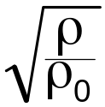
3. True airspeed and indicated airspeed
Equivalent airspeed (EAS), noted EV, is the airspeed corresponding to a given kinetic pressure at s.l. in ISA conditions :
q = ½ρV² = ½ρ₀ EV²
EV = V
Indicated Airspeed (IAS), includes airspeed errors. Calibrated Airspeed (CAS), noted Vc, is the theoretical value, after correction of airspeed errors.
At low speeds and low altitudes, Calibrated airspeed (CAS) is very close to Equivalent airspeed : Vc ≅ EV
Notes:
Kinetic pressure may be expressed as a function of true airspeed and mass density.
Aerodynamic forces and moments are proportional to kinetic pressure, reference surface and aerodynamic coefficients, kinetic pressure is thus essential to define flight envelope.
From the definition of Equivalent Airspeed (abbreviation EAS, noted EV), the relation between Equivalent Airspeed and True Airspeed is :
At low speeds and low altitudes, Equivalent Airspeed may be considered as equal to the Calibrated Airspeed.
Calibrated Airspeed is the general expression for indicated airspeed, valid at all speeds, which will be presented in another section.
Calibrated Airspeed takes into account airspeed errors while Indicated Airspeed includes those errors.
Termes français : q est la pression cinétique, EV est l’équivalent de vitesse.

Slide 22
3. True airspeed and indicated airspeed
Kinetic pressure limitations
  Structural loads increase with kinetic pressure.
  Above some value of q, flutter may be encountered.
  Flutter : instability due to coupling between aerodynamic modes and structural modes.
  Definition of “placard speeds” (maximum IAS) :
    Clean configuration : VMO, VNO/VNE (light airplanes)
    Other speed limitations : VFE (flaps extended), VLE (landing gear extended), VLO (landing gear operation), etc
Notes:
I - <number>
Issue 1 – Feb 2011
I – Principles of straight and steady level flight
For a given load factor, lift does not depend on kinetic pressure (lift equation). However, load distribution is a function of kinetic pressure and loads due to gusts and to control deflections increase with kinetic pressure.
The flight envelope must be flutter free, with sufficient margins to allow limited excursion outside the envelope.
« Placard speeds » are speed limitations, defined in terms of IAS, since IAS is a primary flight information. Design speeds VA, VB, VC, VD and VF are Equivalent Airspeeds defined for structural design.
For commercial airplanes certified under FAR/CS 25 maximum operating speed is VMO. VMO must not be greater than design speed VC : when flying at VMO, if speed increases due to turbulence or other perturbation, speed may increase above VC but should not exceed VD.
For light airplanes certified under FAR/CS 23, VNO is the maximum speed in “normal operations” an VNE is “never exceed speed”. VNO is the maximum speed in turbulent conditions an may be exceeded in still air (cf. next slide).
Maximum indicated airspeed flaps (and or slats) extended VFE, must not be greater than design airspeed flaps extended VF. It is possible to define several values for VFE, each applicable to different flaps/slats settings.
Usually, maximum landing gear operation indicated airspeed VLO is lower than maximum indicated airspeed with landing gear extended VLE in order to limit aerodynamic loads on landing gear doors during landing gear extension or retraction.

Slide 23
3. True airspeed and indicated airspeed
Airspeed Indicator (ASI) and IAS limitations (light airplane)
Stall speed flaps retracted
VFE
Maximum IAS flaps extended
VS clean
VS flaps
extended
80
100
VNO
60
120
Stall speed flaps extended
Maximum IAS
in turbulence
40
140
IAS
20
kt
160
VNE
« Never exceed » speed
Notes:
Indicated Airspeed (IAS) is displayed on the airspeed indicator which may be an independent instrument (left) or a part of an integrated instrument.
This slide presents an airspeed indicator on a light airplane certified under FAR/CS 23.
The green arc represents indicated airspeed range in normal operations :
Minimum indicated airspeed (VS) is stall speed at maximum take-off weight
Maximum indicated airspeed in normal conditions is VNO
The amber arc represents indicated airspeed range in still air conditions (no turbulence) : from VNO to VNE. VNE is represented by a red line.
The white arc represents indicated airspeed range with flaps extended at maximum setting :
Minimum indicated airspeed (VS) is stall speed at maximum take-off weight with flaps extended
Maximum indicated airspeed flaps extended is VFE

Slide 24
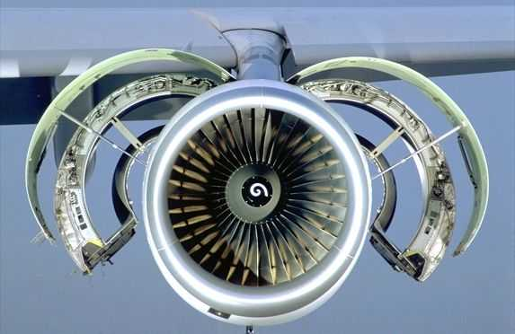
4. General principles of airplane propulsion
Notes:
I - <number>
Issue 1 – Feb 2011
I – Principles of straight and steady level flight
In this chapter general principles of airplane propulsion are presented, focusing on jet propulsion (propeller propulsion is presented in a separate appendix).
Illustration : CFM-56 high bypass turbofan.

Slide 25
4. General principles of airplane propulsion
Intake
Fuel flow Qc
Exhaust
Mass flow Q
Mass flow Qj
Engine
V
Vj
Thrust : F ≅ Qj Vj - QV
Notes:
This slide presents the principle for aerobic propulsion : intake flow is accelerated at exhaust velocity Vj, higher than initial velocity V (true air speed).
The formula for net thrust result from application of the momentum theorem, it applies to all aerobic engines, jet engines as well as propellers.
This formula assumes that exhaust pressure is equal to static pressure at airplane altitude. If it is not the case, the pressure difference has to be taken into account as follows :
F = Qj Vj – Q V + Aj pj – A₀ p
Aj is the exhaust section and pj is the exhaust pressure
A₀ is the intake section and p the static pressure at A/C altitude
For propellers, the intake flow is the airflow passing through the propeller disk. It is thus equal to the exhaust flow (Qj = Q).
For jet engines, the fuel burned in the combustion chamber is ejected and has to be included in the exhaust flow in addition to the air flow passing through the air intake.
Rocket engines : In the case of anaerobic engines (rocket engines), there is no intake flow and the above formula may still be applied with zero values for Q and A₀. Rocket engines are seldom used for aircraft propulsion, mostly as auxiliary engines such as RATO rockets (Rocket Assisted Take-Off).

Slide 26
4. General principles of airplane propulsion
For propeller engines and jet engines, fuel flow is small, compared to air mass flow :
Qj = Q + Qc ≅ Q
If jet velocity is parallel to A/C velocity, the net thrust F is :
F = Q (Vj - V)
Notes:
I - <number>
Issue 1 – Feb 2011
I – Principles of straight and steady level flight
Fuel flow is usually negligible since it represents a small fraction of intake air flow in the case of jet engines and a smaller fraction in the case of propeller engines.
As an example, in the case of a military engine at maximum thrust with afterburner, fuel flow represents usually less than 5 % of airflow (when afterburner is not operating, this fraction is reduced to about 2 %). In the case of current turbofans, with lower specific fuel consumption and lower exhaust velocities, this fraction is much smaller.
Jet velocity may usually be considered as parallel to airplane velocity (air velocity vector), but this is no longer valid in a few particular situations :
jet engines at high angle of attacks,
vectored thrust with high nozzle deflections.
Note : When considering the thrust of a propeller engine, the engine exhaust gases contribution to thrust must be added to the thrust of the propeller itself. In the case of reciprocating engines, this contribution is usually negligible but it has to be taken into account for turboprops (equivalent shaft power is the addition of shaft power and propulsive power produced by exhaust gases contribution to thrust).

Slide 27
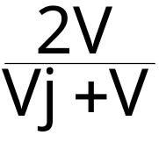
4. General principles of airplane propulsion
The engine must communicate to the flow the power Wk corresponding to the kinetic energy increment :
Wk = ½QVj² - ½QV²
The propulsive power is : W = V.F
Propulsive efficiency : ηp = W/Wk =
The global efficiency is the product of propulsive and thermal efficiencies.
Notes:
I - <number>
Issue 1 – Feb 2011
I – Principles of straight and steady level flight
Propulsive power is the « useful » power : in steady straight level flight it is equal to power required for level flight (cf. chapter dedicated to level flight).
However, to produce a given amount of thrust, the airflow has to be accelerated, which requires a power corresponding to the kinetic energy increase : Wk.
According to the above formula, propulsive efficiency increases when exhaust velocity decreases towards intake velocity.
Global engine efficiency may be defined as the ratio between propulsive power and thermal power produced by fuel burning :
In the above formula, HV is the fuel heat value (in J/kg). When multiplied by fuel flow, we obtain the thermal power corresponding to fuel burning.
Global engine efficiency may be expressed as the product of propulsive and thermal efficiencies.

Slide 28
4. General principles of airplane propulsion
Jet exhaust velocity
A/C Mach number
Propeller
1
Propfan
Turbofan (high bypass)
Turbofan (low bypass)
Turbojet
Variable cycle turbofan
ramjet
scramjet
Propulsive efficiency
Airflow
Notes:
I - <number>
Issue 1 – Feb 2011
I – Principles of straight and steady level flight
The characteristics of an aerobic propulsion system are functions (among other parameters) of the jet velocity. When jet velocity increases (at constant thrust) :
Propulsive efficiency decreases (increased fuel consumption).
Maximum speed increases.
Jet noise increases (jet noise is the noise level due to the difference between aircraft speed and jet velocity).
Engine cross section decreases.
This slide presents aerobic propulsion systems : from top to bottom, jet velocity increases as well as maximum cruise Mach number.
Propeller have good propulsive efficiencies but are limited to subsonic speeds. Propfans (high speed propellers) have been designed for high subsonic cruise (above Mach 0.7) but have failed to reach high rate production levels.
Turbojets and low bypass ratio turbofans are adapted to supersonic cruise while high bypass ratio turbofans are adapted to high subsonic cruise (under Mach 0.9). Variable cycle turbofans, yet to be developed, would benefit from high efficiencies and low noise levels due to high bypass ratios at low speeds, while retaining supersonic capability (with low bypass ratio) in cruise.
Ramjets are adapted to supersonic and hypersonic speeds, but are not capable to run at low speeds (scramjet means supersonic combustion ramjet, designed for hypersonic flight).

Slide 29
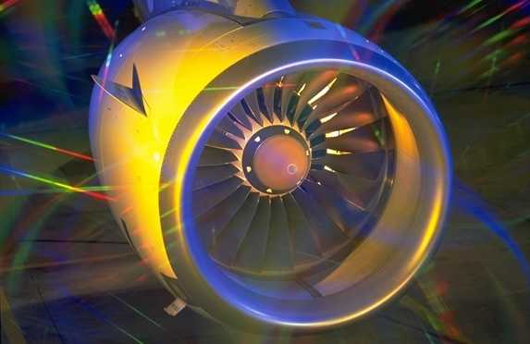
5. Jet propulsion : turbojet and turbofan
Notes:
I - <number>
Issue 1 – Feb 2011
I – Principles of straight and steady level flight
Turbojet appeared during WWII (Me 262 and Gloster Meteor were the first operational jet fighters) allowing for a significant increase in maximum speed and altitude.
Turbofans, or bypass engines, appeared in the 1960’s as a technological improvement improving specific fuel consumption and noise levels while retaining transonic capability.
High bypass ratio turbofans are now the standard engines for commercial transport, from regional jets to wide-bodies.
It must be stressed that since the advent of jet engines, reliability has increased dramatically, allowing for several thousands flight hours between commercial engines overhauls.

Slide 30
5. Jet propulsion : turbojet and turbofan
Turbojet operating principle
Compressor
Fuel
Turbine
Intake
Nozzle
Combustion
chamber
Turbojet operating cycle
1. Adiabatic compression Intake & Compressor
  2. Heat energy addition Combustion chamber
  at constant pressure
  3. Adiabatic expansion Turbine & nozzle
Notes:
I - <number>
Issue 1 – Feb 2011
I – Principles of straight and steady level flight
This slide presents the operating cycle of turbojets, also known as the Brayton cycle.
Air is compressed in the compressor (at high speeds, there is an aerodynamic compression in the air inlet).
In the combustion chamber, combustion takes place at constant pressure;
In the turbine, and then in the nozzle, adiabatic expansion takes place.
Turbine engine operating cycle is similar to reciprocating engines cycle with two significant differences :
In a turbine engine, each operation is performed simultaneously in different locations while in a reciprocating engine, all operations are performed in sequence, in the same place.
The operating cycle of a reciprocating engine is the Otto cycle in which combustion is performed at constant volume instead of constant pressure.

Slide 31
5. Jet propulsion : turbojet and turbofan
Turbofan operating principle
Fan
HP
Turbine
LP
Turbine
HP
Compressor
Basic operating cycle : same as turbojet.
Bypass ratio : cold / hot flow ratio.
Lower exhaust velocity : better propulsive efficiency and lower noise.
High bypass ratio : better SFC, lower noise. Low bypass ratio : for supersonic flight.
Most turbofans have 2 spools : BP (N1) and HP (N2).
Notes:
I - <number>
Issue 1 – Feb 2011
I – Principles of straight and steady level flight
While retaining the basic operating cycle of the turbojet, turbofans offer major improvements in terms of specific fuel consumption and noise level.
In a turbofan, cold flow bypasses the « engine core » and is ejected at lower velocity. This decrease in mean exhaust velocity allows for a propulsive efficiency improvement and a decrease in jet noise level.
Bypass ratio is the ratio between cold flow and hot flow. High bypass engines are well adapted to low transonic cruise (better economy and noise) while low bypass engines have a lower cross section and allow for supersonic cruise.
Most turbofans have twin spool, notorious exceptions being Rolls-Royce RB211 and “Trent” turbofans, which have three spools.

Slide 32
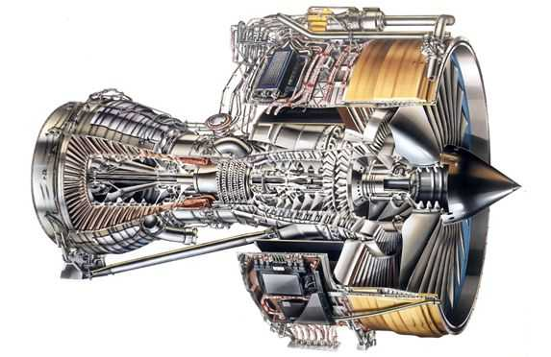
5. Jet propulsion : turbojet and turbofan
Combustion
chamber
Hot flow
Cold flow
Compressor
Fan
Turbine
Notes:
I - <number>
Issue 1 – Feb 2011
I – Principles of straight and steady level flight
This slide presents a high bypass turbofan.
It must be stressed that achieving high compression ratios requires numerous compressor stages (as well as several turbine stage).
Recent engines have digital controls through FADEC (Full Authority Digital Engine Controls), while older engines are controlled by hydro mechanical controls.
The high pressure spool (N2) is used to drive accessories such as electrical generator (usually through a constant speed drive) or hydraulic pumps.
Engine is also used as an air source through engine bleeds, from compressor stages.

Slide 33
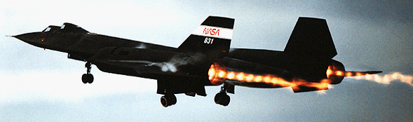
5. Jet propulsion : turbojet and turbofan
Reheat (or afterburner)
  Additional combustion downstream of the turbine, to increase exhaust velocity.
  Higher thrust for low weight increase but higher specific fuel consumption and noise level.
Notes:
I - <number>
Issue 1 – Feb 2011
I – Principles of straight and steady level flight
Dry thrust (without reheat) is usually limited by turbine inlet temperature, but fuel to air ratio allows for an additional combustion downstream of the turbine.
The reheat increases maximum thrust at a minimum price in terms of weight and complexity, when compared to an increase in engine size, while retaining the same diameter.
However, reheat thermal and propulsive efficiency are low, increasing specific fuel consumption.
Due to high exhaust velocities, jet noise increases dramatically.
As a consequence of high specific fuel consumption, reheat should be used only temporarily, to increase thrust during take-off, for maneuvering in combat, or for supersonic « dash » (most combat airplanes are not capable of supersonic cruise, since reheat is required to maintain supersonic flight).
« Concorde » used to be the only civil aircraft with reheated engines, used for take-off and for supersonic acceleration, from Mach 0.93 to Mach 1.7.

Slide 34
5. Jet propulsion : turbojet and turbofan
Engine thrust is limited by :
  Mechanical limitations : rotation speeds, etc
  Thermal limitations : turbine inlet temperature, etc
  Operational limitations (« red lines ») : max N1 (fan rpm), N2 (high pressure rpm), max EGT («Exhaust Gases Temperature), …
Maximum thrust :
  Variations with speed depend on the bypass ratio and the flight conditions (Mach number and altitude).
  Decreases when altitude increases.
  Decreases when temperature increases (except, at low temperatures, when engine is « flat rated »).
Notes:
I - <number>
Issue 1 – Feb 2011
I – Principles of straight and steady level flight
Jet engine performance is defined in terms of thrust instead of power, since thrust evolution with speed is much lower than power evolution (cf. next slide).
Thrust is limited by mechanical and thermal limitations, such as rotation speeds and internal temperature.
Maximum turbine inlet temperature is the main parameter limiting engine thrust : with current technologies, maximum temperature is about 1500 K for engines with air-cooled turbine blades.
Usually, maximum thrust is a function of the selected rating :
TOGA : Take-Off and Go Around rating, available only for a limited amount of time (usually, 5 to 10 minutes)
MCT : Maximum continuous thrust rating
CLB : Maximum climb rating
MCR : Maximum cruise rating
Maximum thrust variations with speed are presented on the next slide.
Maximum thrust decreases when altitude increases, due to lower air density (when air density decreases, fuel flow has to be reduced to maintain a constant turbine inlet temperature).
Temperature influence on thrust is similar except for flat-rated engines, designed so as to maintain constant maximum thrust at a given altitude, up to a maximum temperature (usually ISA+15°C). In this case, temperature limitations are not reached if external temperature is lower than flat rating temperature).

Slide 35
5. Jet propulsion : turbojet and turbofan
Examples of thrust evolution with speed and altitude
Max. thrust
Fu
High bypass ratio
turbofan
Max Take-off Thrust
Mach
0.3
Max. thrust
Fu
High bypass ratio
turbofan
Max cruise Thrust
Mach
0.8
Notes:
I - <number>
Issue 1 – Feb 2011
I – Principles of straight and steady level flight
Evolution of maximum thrust with Mach number depends on the engine operating cycle.
Maximum thrust for high bypass turbofans decreases when speed increases (upper sketch). However, at cruising altitudes, thrust variations with Mach number may usually be neglected (middle sketch).

Slide 36
5. Jet propulsion : turbojet and turbofan
Specific fuel consumption (SFC) is the fuel flow to thrust ratio : Ch = Cs . F
  Ch : fuel flow (kg/h) ;
  F : thrust (N)
  Cs : SFC (kg/N/h)
Order of magnitude for SFC in cruise :
1 kg/daN/h (0.1 kg/N/h)
  Depends on flight conditions and thrust level (optimum at the « bucket »)
Notes:
I - <number>
Issue 1 – Feb 2011
I – Principles of straight and steady level flight
Specific fuel consumption for a jet engine is different from SFC definition for a propeller engine, since it refers to thrust instead of power.
High bypass turbofans have lower SFCs, as low as 0.6 kg/daN/h in cruise condition at the « bucket » (cf. next slide).
SFC for turbojets may be much higher : as high as 2 kg/daN/h for a turbojet with reheat on.
Note : It must be stressed that take-off SFC is lower than cruise SFC. This may be explained by the fact that jet engine SFC is defined in terms of thrust instead of power (for a given thrust, power is lower at lower speeds). For current turbofans, order of magnitude for SFC at take-off is 0.3 kg/daN/h.

Slide 37
5. Jet propulsion : turbojet and turbofan
Evolution of Specific Fuel Consumption with thrust level
Optimum thrust for SFC close to maximum thrust
SFC
Minimum SFC : « bucket »
Thrust
Idle
Thrust
Max.
Thrust
Fu
Notes:
I - <number>
Issue 1 – Feb 2011
I – Principles of straight and steady level flight
This slide presents the « bucket » for minimum SFC.
In cruise conditions, SFC is minimal for a thrust rating close to maximum thrust. This may be explained by better thermal efficiency when temperature increase (for turboprops, influence of power rating on SFC is similar).

Slide 38

6. Straight and steady level flight performance
Notes:
I - <number>
Issue 1 – Feb 2011
I – Principles of straight and steady level flight

Slide 39
6. Straight and steady level flight performance
Lift equation mg = ½ρV²SCz
Propulsion equation F = ½ρV²SCx
Z
Lift
F
G
Thrust
X
Drag
V
Velocity vector
mg
Weight
Notes:
I - <number>
Issue 1 – Feb 2011
I – Principles of straight and steady level flight
This figure presents the forces acting on an airplane in straight and level flight :
Thrust (F), is assumed to be parallel to the velocity vector, and, in this case, horizontal.
Drag (X = qSCx), is parallel and opposed to the velocity vector.
Weight (mg), is vertical, and thus normal to the velocity vector.
Lift (Z = qSCz) is normal to the velocity vector.
To maintain straight and level flight, lift must balance weight, and tangential acceleration results from the difference between thrust and drag.
Note : in the above slide, tangential acceleration is expressed as the time derivative of true airspeed, which is true only when wind is constant (tangential acceleration is the time derivative of ground speed).

Slide 40
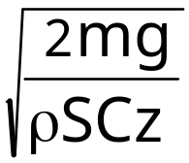
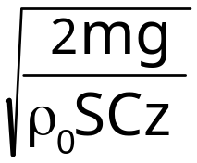
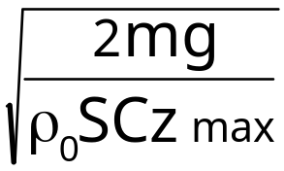
6. Straight and steady level flight performance
Speed and lift coefficient
Lift equation
mg = ½ρV² S Cz = ½ρ₀EV² S Cz
Lift coefficient and speed
  True airspeed V=
  Equivalent Airspeed EV =
Stall speed (CAS) under « 1 g » load factor
    Vs_{1g} = (CAS ≅ EAS at low speed/altitude)
Notes:
I - <number>
Issue 1 – Feb 2011
I – Principles of straight and steady level flight
Lift equation allows to express airspeed as a function of mass and lift coefficient (assuming that normal thrust component is neglected).
In straight and level flight (n_{z} = 1), for a given mass :
True airspeed, V, is a function of lift coefficient and air density
Equivalent airspeed, EV, is a function of lift coefficient only
For a given lift coefficient, Equivalent airspeed is proportional to the square root of mass.
The stall speed under « 1 g » load factor, Vs_{1g}, is the minimum calibrated airspeed allowing for straight and level flight. It corresponds to the maximum lift coefficient
The above expression for Vs_{1g} is obtained assuming that anemometric errors are negligible (Indicated Airspeed = Calibrated Airspeed), and that calibrated airspeed is equal to equivalent airspeed (this assumption is valid at low speeds and low altitudes corresponding to stall demonstrations).

Slide 41
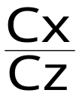
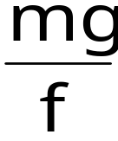
6. Straight and level flight performance
Thrust required for level flight, Fn
  Straight level flight at constant speed
  Propulsion equation F = ½ρV² S Cx
  Lift equation mg = ½ρV² S Cz
  Thrust must balance drag in order to maintain constant speed and altitude
Fn = ½ρV² S Cx
Fn = mg =
  f is the lift over drag ratio
Notes:
I - <number>
Issue 1 – Feb 2011
I – Principles of straight and steady level flight
Thrust required for level flight (sometimes called « thrust required »), is the thrust required to maintain straight and level flight at constant airspeed (assuming constant wind).
In the above expression, normal thrust component is neglected
Lift equation is used to obtain lift coefficient as a function of mass and kinetic pressure:
Drag coefficient is a function of lift coefficient and Mach number :
Cx = Cx(Cz,M)
Note : Drag coefficient is also function of parameters such as center of gravity location (trimmed drag polar), kinetic pressure (when flexibility is taken into account), Reynolds number, etc. Thrust may also have some influence on drag through aerodynamic interaction and pitch equilibrium (elevator or pitch trim setting for equilibrium is a function of thrust).We may assume that such terms have a secondary influence on drag coefficient, and thus, on thrust required for level flight.
For a given mass and altitude, thrust required is minimal when the lift coefficient corresponds to maximum L/D ratio.

Slide 42
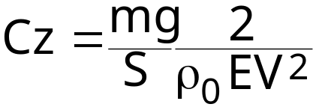
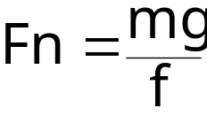
6. Straight and steady level flight performance
In straight and steady level flight
  Lift coefficient Cz is function of Equivalent Airspeed and wing loading (mg/S) :
  Thrust required for level flight depends only on weight and lift over drag ratio f.
  At low speeds :
  EV ≅ Vc (Equivalent Airspeed ≅ Calibrated Airpeed)
  Lift over drag ratio is a function of lift coefficient (incompressible drag polar)
Notes:
I - <number>
Issue 1 – Feb 2011
I – Principles of straight and steady level flight
In straight and steady level flight lift coefficient, Cz, is a function of equivalent airspeed and wing loading.
At low speeds and low altitude, equivalent airspeed may be considered as equal to calibrated airspeed (and indicated airspeed if airspeed errors are neglected).
Since lift over drag ratio f (Cz/Cx) is a function of lift coefficient only at low altitudes and low speeds (incompressible drag polar), thrust required for level flight is a function of lift coefficient. It is thus a function of equivalent airspeed and wing loading (independent from pressure-altitude and temperature).

Slide 43
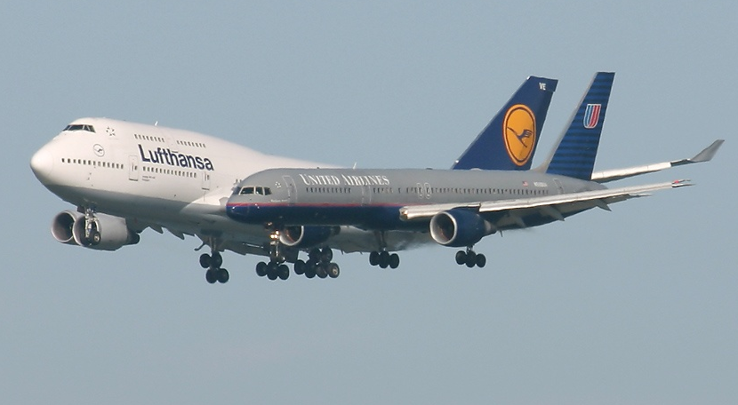
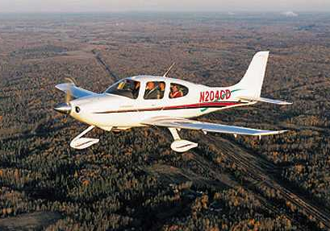
6. Straight and steady level flight performance
Wing loading
  For a given lift coefficient, when wing loading increases, equivalent airspeed increases
Commercial jets
m/S ≅ 700 kg/m2
Light single engine
piston airplanes
m/S ≅ 100 kg/m2
Notes:
I - <number>
Issue 1 – Feb 2011
I – Principles of straight and steady level flight
The wing area must be sufficient to allow for the lift to balance weight.
For a given value of the lift coefficient, lift is proportional to the wing area and to the square of airspeed.
The consequence of a high wing area is a low wing loading : for a given maximal lift coefficient, the minimum flight speed (stall speed) will be lower. But the penalty for a high wing area is increased structural weight and increased friction drag.
A low wing area (high wing loading), designed for optimization at high cruise speeds (and for low structural weight), has a negative consequence in term of minimum speeds (thus increasing take-off and landing distances). This may be compensated by high lift devices, in order to improve low speed performance at the price of added weight and complexity.
Light airplanes, flying at low speeds, requiring good low speed performance for the use of short runways, have low wing loading (usually less than 100 kg/m², and less than 50 kg/m² for gliders and very light airplanes). For simplicity, most light airplanes have simple high lift devices such as flaps, with no slats (lighter airplanes having no flaps).
Commercial airplanes, have high wing loadings (order of magnitude : 700 kg/m²) optimized for transonic cruise. Flaps and slats are used for take-off and landing, to increase maximum lift coefficient. At maximum take-off weight, the required take-off runway length for a long range airplane often exceeds 3000 m.

Slide 44
6. Straight and steady level flight performance
Incompressible drag polar
V ⇒ Cz ⇒ Cx (Cz) ⇒ Fn = mg Cx/Cz
lift equation Drag polar
Thrust required
Fn
Symmetrical drag polar
Cx = Cx₀ + k Cz²
Stall
Maximum L/D
Induced drag = Zero lift drag
min. Fn
Induced drag
~ 1/V²
Zero lift drag
~ V²
True Airspeed
V
Notes:
I - <number>
Issue 1 – Feb 2011
I – Principles of straight and steady level flight
In the case of a symmetrical, incompressible drag polar, the expression for drag coefficient is :
Cx = Cx₀ + k Cz²
Thrust required for level flight may be expressed as a function of airspeed :
The first terms corresponds to pressure drag, the second term corresponding to induced drag.
The minimum thrust required, which corresponds to the minimum drag for this mass and altitude, is obtained when lift coefficient equals :
In this case, induced drag coefficient equals pressure drag coefficient (Cx₀).

Slide 45
6. Straight and steady level flight performance
Constant lift coefficient Cz ⇒ Cx = Cx(Cz)
Influence of mass m
  True Airspeed V, Equivalent Airspeed EV are proportional to √m
  Thrust required, Fn is proportional to m
Influence of air density ρ
  True Airspeed V is proportional to 1/√ρ
  Equivalent Airspeed EV is independent from ρ
  Thrust required Fn is independent from ρ
Notes:
I - <number>
Issue 1 – Feb 2011
I – Principles of straight and steady level flight
True airspeed, equivalent airspeed, thrust required and power required may be expressed as functions of lift and drag coefficients, mass and air density :
Assuming an incompressible drag polar, for a given lift coefficient Cz, drag coefficient is constant and does not depend on airspeed. From the above expressions, we can thus derive the influences of mass and air density on V, EV and Fn (assuming constant lift coefficient).

Slide 46
6. Straight and steady level flight performance
Thrust diagram (jet airplane)
Thrust
F
Maximum engine thrust Fu
τ
Engine thrust for intermediate
lever angle τ
Thrust required Fn
min. Fn/V
min. Fn
idle thrust (τ = 0)
Max.
L/D
Min.
Cx/√Cz
True Airspeed
V
Stall
Notes:
I - <number>
Issue 1 – Feb 2011
I – Principles of straight and steady level flight
Thrust diagrams present thrust required Fn and engine thrust as functions of airspeed. A thrust diagram is valid for given airplane mass, altitude and temperature.
This diagram is mainly used for jet airplanes : at given altitude and temperature, engine thrust is a function of airspeed and thrust lever angle. It varies from idle thrust to maximum thrust.
On the thrust required versus speed curve, 3 points are marked :
Stall speed, minimum airspeed for stabilized flight, corresponding to maximum lift coefficient.
Minimum thrust required, corresponding to maximum lift over drag ratio.
Minimum thrust required over airspeed ratio, corresponding to the minimum value for Cx/√Cz. Assuming constant specific fuel consumption, this speed allows for maximum range.
In the above figure, thrust required is lower than maximum engine thrust in the whole speed range : speed is not limited by thrust but by other considerations (VMO/MMO are maximum design CAS/Mach). This is generally the case for jet engines, except at higher altitudes, close to propulsion ceiling.

Slide 47
6. Straight and steady level flight performance
Drag polar and thrust diagram (jet airplane)
Cz
Stall
Cz_{max}
Cz₁
Max L/D ⇒ Min. Fn
Cz₃
Min Cx/Cz^{1/2} ⇒ Min. Fn/V
Cx
Notes:
I - <number>
Issue 1 – Feb 2011
I – Principles of straight and steady level flight
This figure presents particular points on an incompressible drag polar :
Stall speed corresponds to the maximum lift coefficient Cz_{max}.
Lift coefficient for maximum L/D, noted Cz₁, corresponding to minimum thrust required and minimum power required to speed ratio.
Lift coefficient for minimum Cx/√Cz, noted Cz₃, corresponding to the minimum thrust required to speed ratio.
In the case of a symmetrical drag polar (Cx = Cx₀ + k Cz²) :
Note 1 : If the influence of Mach number on drag coefficient is not negligible (incompressible drag polar hypothesis not valid), this is no longer valid since Mach number varies along with speed.
Note 2 : in the case of a non symmetrical drag polar, the expressions are detailed below (Cx = Cx_{min} + k (Cz-Cz_{opt})²).

Slide 48

7. Endurance and range (jet airplanes)
Fuel flow (kg/h) Ch = Cs.Fn
  Cs is the SFC (kg/N/h)
  Fn is the thrust required for level flight
  Ch = Cs mg
Maximum endurance ⇔ minimum fuel flow
At a given altitude, maximum endurance will be obtained at the speed corresponding to minimum thrust required (best L/D)
Assuming constant SFC and incompressible drag polar, at a given lift coefficient, fuel flow does not depend on altitude.
Notes:
I - <number>
Issue 1 – Feb 2011
I – Principles of straight and steady level flight
If we assume that thrust increases when fuel flow increases, maximum endurance will be obtained when thrust required for level flight is minimal : best lift over drag ratio. This assumption is usually valid but the two additional assumptions (constant SFC and incompressible drag polar) are usually valid only for a limited altitude range.
According to the above formula, holding speed, should correspond to best lift over drag ratio, or minimum drag (minimum thrust required).
However, recommended holding speed may slightly differ from this speed corresponding to best lift over drag ratio for several reasons :
The above expressions apply to straight and level flight while standard holding patterns include turns (at a given airspeed, lift coefficient is higher in turns, when compared to straight and level flight, requiring increase of thrust to maintain level flight at constant airspeed).
Holding speeds must satisfy other constraints such as margins relative to stall speeds and maximum speeds to minimize holding pattern area (turning radius increase with speed).

Slide 49
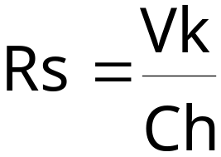
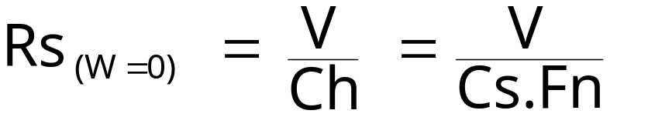
7. Endurance and range (jet airplanes)
Specific range, noted Rs, is the distance flown per unit fuel.
  Unit for Rs : nm/kg or nm/t.
  Vk : ground speed in knots
  Ch : fuel flow in kg/h (or t/h)
Still air specific range :
  Best still air specific range obtained when Fn/V is minimal
Notes:
I - <number>
Issue 1 – Feb 2011
I – Principles of straight and steady level flight
It must be stressed that specific range decreases when aircraft mass increases, since fuel flow increases with weight.
Actual specific range is a function of wind.
Still air specific range reflects aircraft performance.
Relationship between actual specific range with effective wind W and still air specific range is :

Slide 50
7. Endurance and range (jet airplanes)
Thrust
F
Thrust required Fn
Maximum
Endurance
min. Fn/V
min. Fn
Maximum
range
Equivalent
Airspeed
EV
Stall
Max.
L/D
Min.
Cx/√Cz
VMO
Cruising
speeds
Notes:
I - <number>
Issue 1 – Feb 2011
I – Principles of straight and steady level flight
The above slide presents equivalent airspeeds for maximum endurance and maximum range in the thrust diagram.
This diagram presents thrust required for level flight as a function of equivalent airspeed, which is independent from altitude and temperature if the incompressible drag polar hypothesis is valid.
Maximum endurance is achieved when thrust required for level flight, Fn, is minimal. This corresponds to minimum lift over drag ratio.Corresponding lift coefficient is Cz₁. This is valid if thrust increases when fuel flow increases (minimum thrust corresponds to minimum fuel flow), which is usually the case for jet engines.
If specific fuel consumption SFC is constant, maximum range (in still air) corresponds to the minimum of Cx/√Cz. Corresponding lift coefficient is Cz₃. It has been shown that specific fuel consumption is a function of thrust rating and is not a constant. As a consequence, « maxi range » speed will be slightly different from the theoretical value presented on the slide.
Cruising speeds are usually above speed corresponding to maximum range (« maxi-range speed ») since economical optimum for speed is a compromise between speed and fuel economy (cf. next slide).

Slide 51
7. Endurance and range (jet airplanes)
Speed, altitude and economy
  Direct operating cost per leg is the addition of :
    Fixed expenses (ATC fees, etc),
    Fuel expenses,
    Time dependant expenses (crew, maintenance, etc).
  When cruising speed increases :
    For a given leg (fixed distance), time dependant expenses decrease
    Airplane productivity increases : it is possible to fly more legs with a given number of airplanes
    Better customer acceptance
  Consequence : optimum speed is higher than maxi-range speed.
Notes:
I - <number>
Issue 1 – Feb 2011
I – Principles of straight and steady level flight
« Maxi range » conditions define the conditions for optimum specific range, minimizing fuel burnt per nautical mile flown.
However, since direct operating cost per leg is also a function of flight time, optimum speed, for minimum direct operating cost will be higher than maxi range speed.
Furthermore, higher cruising speeds increase A/C productivity (number of legs flown per day), increasing return on investment.
Flight management systems compute optimum (minimum cost) speeds and altitudes (climb speed, cruising altitude, cruising speed/Mach and descent speed), taking into account fuel expenses as well as other expenses. Computations are based on a cost index which reflects the ratio between non fuel expenses and fuel expenses : when cost index is zero, the FMS minimizes burnt, when cost index is set at its maximum value, the FMS minimizes flight time.

Slide 52
7. Endurance and range (jet airplanes)
Influence of altitude (or temperature) : when altitude increases air density ρ decreases
  For a given mass, lift coefficient Cz is a function of equivalent airspeed EV (mg = ½ρ₀EV² S Cz)
  True airspeed increases when altitude increases : (½ρV² = ½ρ₀EV²)
  Under the incompressible drag polar assumption, drag coefficient is function of lift coefficient only : thrust required Fn (EV) does not depend on altitude
  If SFC is constant, fuel flow does not depend on altitude
  Specific range increases when altitude increases
Notes:
I - <number>
Issue 1 – Feb 2011
I – Principles of straight and steady level flight
Under the incompressible drag polar assumption, optimum cruising altitude should be the highest altitude available.
When pressure altitude (or temperature) increases, air density, ρ, decreases.
For a given equivalent airspeed, corresponding to a given lift coefficient (for a given wing loading mg/S), expressions for true airspeed, fuel flow and specific range are :
Note : in the formula for specific range, to obtain a specific range in nm/kg, speed must be expressed in kt (nm/h) and fuel flow in kg/h. When speed is expressed as a function of wing loading, air density and lift coefficient, it is implicitly expressed in international system unit (m/s), a 3600/1852 factor must thus been added in order to convert speed into knots.
As a consequence, when altitude increases, for a given equivalent airspeed, true airspeed increases and specific range increases.
Regarding endurance, under the incompressible drag polar and constant SFC hypothesis, altitude is neutral : fuel flow is independent from air density.

Slide 53
7. Endurance and range (jet airplanes)
Under the preceding assumptions, cruising altitude must be the higher possible :
  Higher cruising speed (shorter time per leg)
  Better specific range (lower fuel burnt per leg)
That explains why jet airplanes fly at higher altitudes (when compared to propeller airplanes)
But, in real life, we have to take into account two phenomena :
  SFC decreases when altitude increases (higher Fn/Fu ratio)
  Drag increases when altitude increases (compressibility effects)
Notes:
I - <number>
Issue 1 – Feb 2011
I – Principles of straight and steady level flight
As long as the incompressible drag polar is valid, there are cumulative benefits in flying at higher altitudes :
Faster cruising speed
Better specific range (which may increase further is specific fuel consumption decreases with altitude, which is usually the case)
This give us first explanation to the fact that optimum cruising altitudes for jet airplanes are higher than propeller airplane cruising altitude, even for relatively short legs, when most of flight time is spent in climb and descent.
However, this is true as long as incompressible drag polar is valid, but it will be shown that above some altitude compressibility effects arise with effects on both true airspeed (Mach number, which is the ratio between true airspeed and sound velocity, must be limited) and drag (which increases with Mach number).

Slide 54
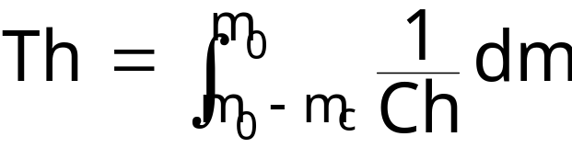
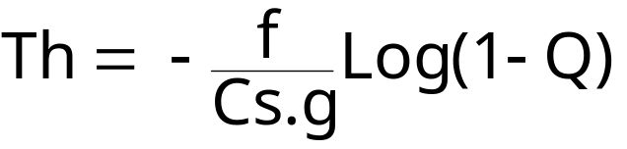
7. Endurance and range (jet airplanes)
Endurance is the time Th flown using a given fuel quantity
    Endurance Th is expressed in hours if fuel flow Ch is expressed in kg/h (or t/h)
    m₀ is the initial mass, m_{c} is the fuel mass an Q is the fuel fraction (Q=m_{c}/m₀)
  Under the following assumptions :
    Constant SFC,
    Constant lift coefficient (speed proportional to square root of mass)
    incompressible drag polar : constant L/D ratio f.
Notes:
I - <number>
Issue 1 – Feb 2011
I – Principles of straight and steady level flight
The above formula for fuel endurance is obtained assuming the following hypothesis :
Constant specific fuel consumption.
Constant lift over drag ratio, which supposes a constant lift coefficient and an incompressible drag polar. To maintain a constant lift coefficient, indicated airspeed must decrease along the time, according to fuel consumption.
Formula for fuel endurance is obtained by integration. The fuel fraction representing the ratio between fuel quantity used for endurance and the initial mass.
According to these hypothesis, fuel endurance does not depend on altitude and temperature.
For civil aircraft, endurance is associated with holding time : it may be necessary to hold over a navigation fix due to delays associated with air traffic management or to wait for weather conditions improvement.

Slide 55
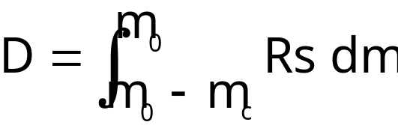
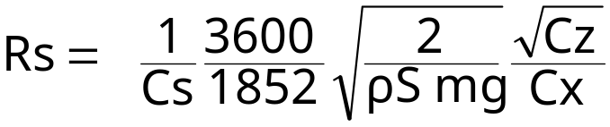
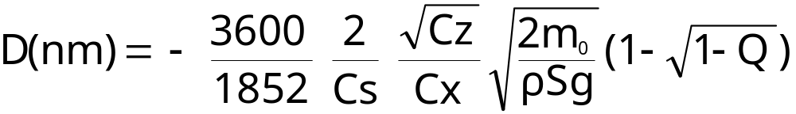
7. Endurance and range (jet airplanes)
Range is the distance D flown using a given fuel quantity
  Still air specific range is expressed as follows (in nm/kg) :
  Breguet-Leduc formula is obtained with the following hypothesis :
    Constant SFC,
    Constant lift coefficient (speed proportional to square root of mass) and constant air density
    incompressible drag polar : constant L/D ratio f.
Notes:
I - <number>
Issue 1 – Feb 2011
I – Principles of straight and steady level flight
This slide presents Breguet-Leduc formula which allows to obtain range under hypothesis of incompressible drag polar, constant specific fuel consumption and constant altitude and temperature (constant air density ρ).
The 3600/1852 factor is used to obtained specific range in nautical miles, from speed expressed in I.S. units (m/s) since it is derived from the lift equation, and specific fuel consumption expressed in kg/N/h.
Flying at a constant lift coefficient and constant air density, true airspeed decreases along with fuel burnt (mass decreases). Incompressible drag polar hypothesis is thus required, in order for drag coefficient to be constant when true airspeed decreases (Mach number decreases).
It must be stressed, that, even under the above mentioned hypothesis this formula is not sufficient to obtain the actual range of an airplane, since we must account for :
Distance and fuel consumption during take-off, climb, descent, approach and landing
Regulatory reserves, usually including allowance for uncertainties (percentage of total fuel), fuel for diversion to alternate airport and final reserve for holding for a given time at destination (or alternate)

Slide 56

7. Endurance and range (jet airplanes)
Influence of wind on specific range
Rs(V,W) = (1 + ) Rs(V,0) V is the TAS
W is the tailwind component
Maxi-range
speeds
Specific range
Rs
Tail
wind
Rs max.
still air
1 % Rs_{max}
Still
air
Head
wind
Maxi-range
speed (still-air)
« Long-range »
speed
True Airspeed
V
Notes:
I - <number>
Issue 1 – Feb 2011
I – Principles of straight and steady level flight
Specific range, taking into account a tailwind component W (or a headwind when W is negative), may be expressed as follows :
As a result, maxi range speed increases when there is a head wind and decreases when there is a tail wind.
Long range speed is the speed which achieves a still air range equal to 99 % of maximum still air range, allowing a speed increase at a small price in terms of fuel burnt.
When wind component (head or tail) is not known with certainty, long range speed may be a good option, since it offers a minimal fuel penalty which decreases when there is a strong head wind (actual maxi range speed increases and is close to long range speed).

Slide 57
7. Endurance and range (jet airplanes)
Payload – Range diagram
Payload is limited by maximum zero fuel weight MZFW
(Structural limitation)
Payload
Payload and fuel are limited by maximum take-off weight MTOW (structural or performance limitation)
Fuel is limited by maximum tank capacity
Range
Notes:
I - <number>
Issue 1 – Feb 2011
I – Principles of straight and steady level flight
The payload versus range diagram presents the A/C economical capability.
The range is usually a still air range (headwind as to be taken into account). It takes into account climbing to optimum altitude, cruise, descend and landing, as well as reserve fuel according to operational regulations (diversion to an alternate airport and holding time).
Maximum payload is usually limited by the maximum zero fuel weight which is an operational limitation (constrained by structural considerations).
At maximum zero fuel weight, fuel is usually limited by maximum take-off weight. Maximum take-off weight may be the structural limitation (maximum certified take-off weight), or limited by performance considerations (this may be the case when runway is short, or under high temperature, high altitude conditions or when take-off path is constrained by obstacles).
At maximum take-off weight, range may be increase by trading payload against fuel, until maximum fuel capacity is reached.
With full tanks (maximum fuel capacity), range increases when payload decreases (specific range increases when mass decreases) and maximum range is obtained with full tanks and zero payload (ferry range).

